Slide 1
Visualization
The Visualization Pipeline
Human Factors
Data Description
Classification of Visualization Methods
Visualization of Multiparameter Data

Slide 2
In general, the content of all slides can be asked in the exam.
Some content is very likely to be asked in the exam. Marked with this sign:
Some content will not be asked. Marked with this sign:
very important
exam

Slide 3
The Visualization Pipeline

Slide 4
The Visualization Pipeline
very important
The process of converting data to images contains the steps: Filtering, Mapping, Rendering
simulation
data bases
sensors
data acquisition
raw data
filtering
vis data
The Visualization Pipeline
mapping
renderable representation
rendering
images, video
interaction

Slide 5
The Visualization Pipeline
Filtering:
starts with raw data
raw data is prepared for the visualization
result is filtered data which go to the mapping step
➔ data to data map
data
filtering
mapping
rendering
image

Slide 6
The Visualization Pipeline
Operations for filtering:
completing the data set
if data values are missing
by interpolation
reduce data set
remove non-relevant data by certain criteria
smoothing data
apply filter and smoothing operators
compute characteristic properties of the data
gradients
extreme values
metadata
apply conversions
data
filtering
mapping
rendering
image

Slide 7
The Visualization Pipeline
Mapping:
conversion of the data into renderable 2D or 3D graphical primitives and their attributes (e.g. creating a polygon list or a triangular mesh)
consider expressiveness, effectiveness, appropriateness
➔ data to geometry map
data
filtering
mapping
rendering
image

Slide 8
The Visualization Pipeline
To find good mappings, theories, algorithms and guidelines from different disciplines are used:
computer graphics
computer vision
perception theory
user interface design
information processing
psychology
arts
data
filtering
mapping
rendering
image

Slide 9
The Visualization Pipeline
Rendering:
Generating a 2D image, video, stereo image
➔ geometry to image map
data
filtering
mapping
rendering
image

Slide 10
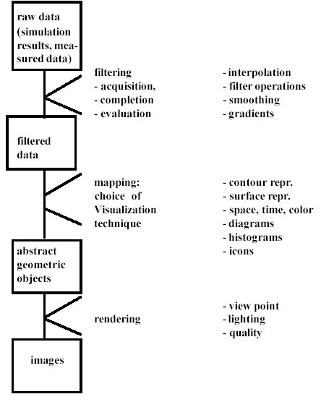
The Visualization Pipeline
Data flow in the Visualization pipeline

Slide 11
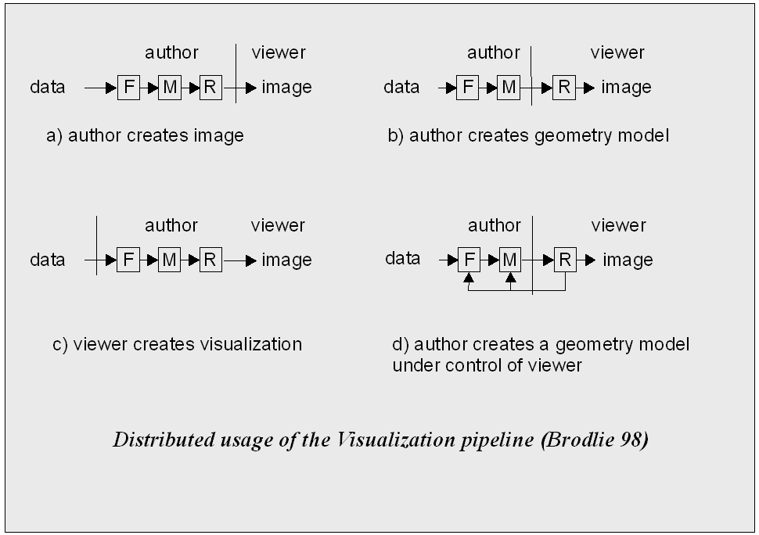
The Visualization Pipeline
The visualization pipeline can be processed in a distributed environment, which gives the following distinction:

Slide 12
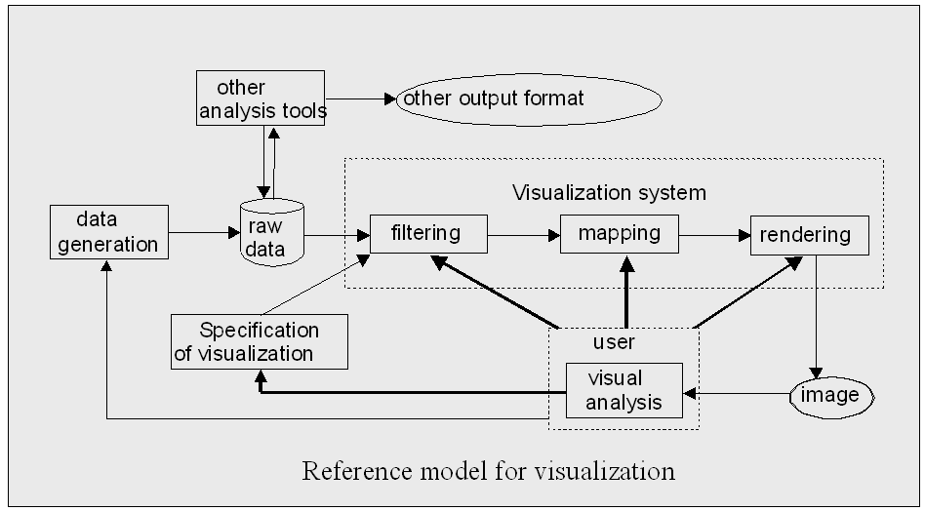
The Visualization Pipeline
Reference model for Visualizations (Robertson):

Slide 13
Visualization Scenarios

Slide 14
Visualization Scenarios
How strong is the visualization connected to the creation of the data?

Slide 15
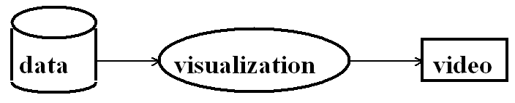
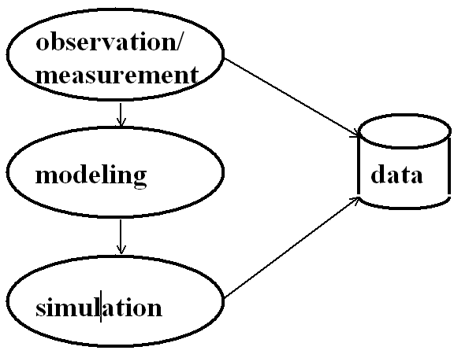
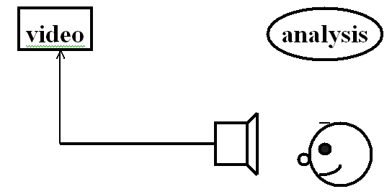
Visualization Scenarios
Movie mode:
2) creating a movie
1) data acquisition
3) analysis of the data in motion
Notes:
Very well suited for visualizations that require lots of computation time due to e.g. very large data or time-consuming visualizations algorithms

Slide 16
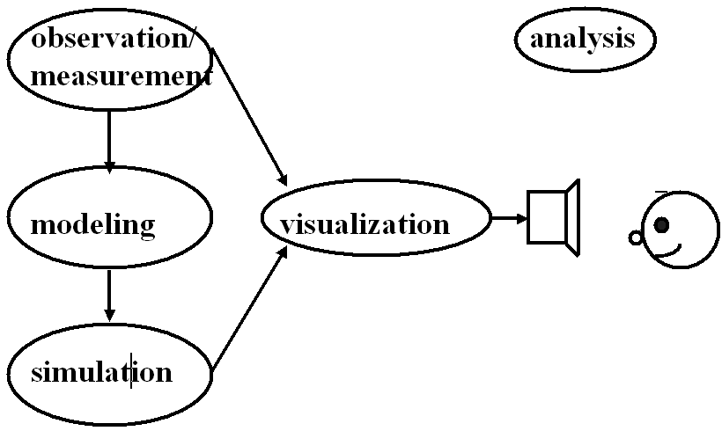
Visualization Scenarios
Tracking:
analysis is directly combined with modeling and simulation
no interactive data processing

Slide 17
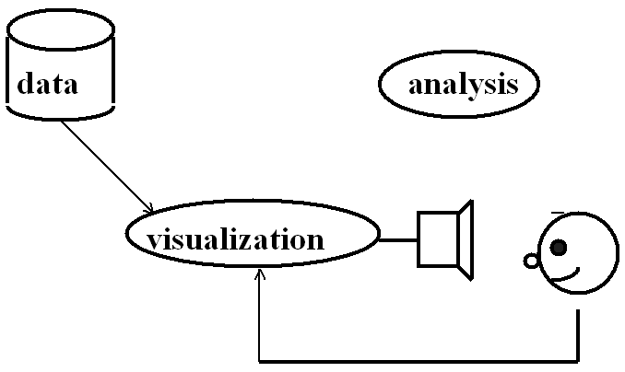
Visualization Scenarios
Interactive post-processing (most common):
1) data acquisition
2) visualization and interactive processing of the data

Slide 18
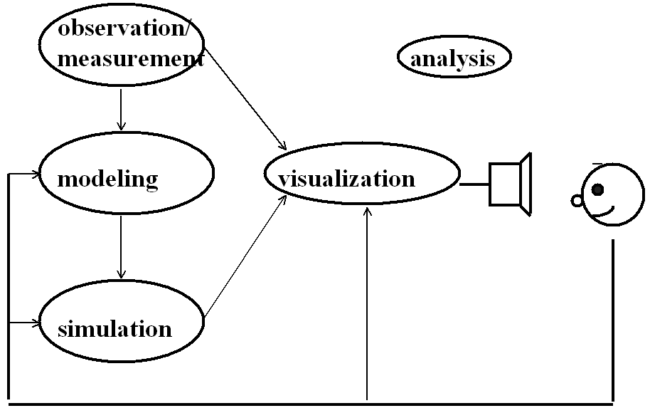
Visualization Scenarios
Interactive steering:
analysis is directly combined with modeling, simulation and visualization; interactive feedback

Slide 19
Visualization Scenarios
Interactive steering, an example:
Generation of 3D geometries during simulation
Geometry streaming to client, that can steer both visualization and simulation.
Tele-Immersion in Wide Area Networks
S. Olbrich, T. Weinkauf, A.Merzky, H.-C. Hege
DFN-funded project of RRZN & ZIB, 2001

Slide 20
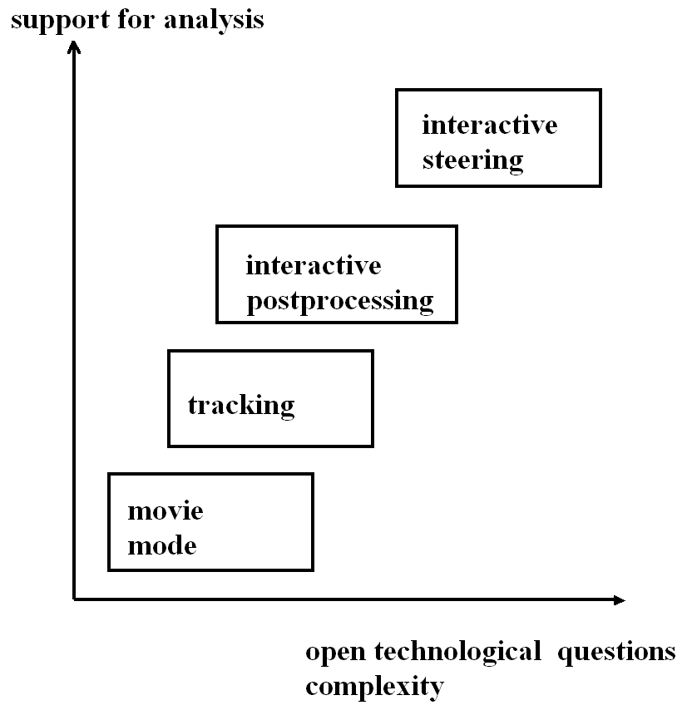
Visualization Scenarios

Slide 21
Visualization Scenarios
Movie mode
- very low flexibility
+ low complexity
+ very low demands on viewing device
- high demands on data storage
disconnected from simulation
Tracking
- very low flexibility
+ low complexity
+ low demands on viewing device
+ low demands on data storage
connected to simulation
Interactive post-processing
+ high flexibility for Vis
+/- medium complexity
- high demands on viewing device
- high demands on data storage
disconnected from simulation
Interactive steering
+ high flexibility for Sim & Vis
- high complexity
- high demands on viewing device
+/- medium demands on data storage
connected to simulation

Slide 22
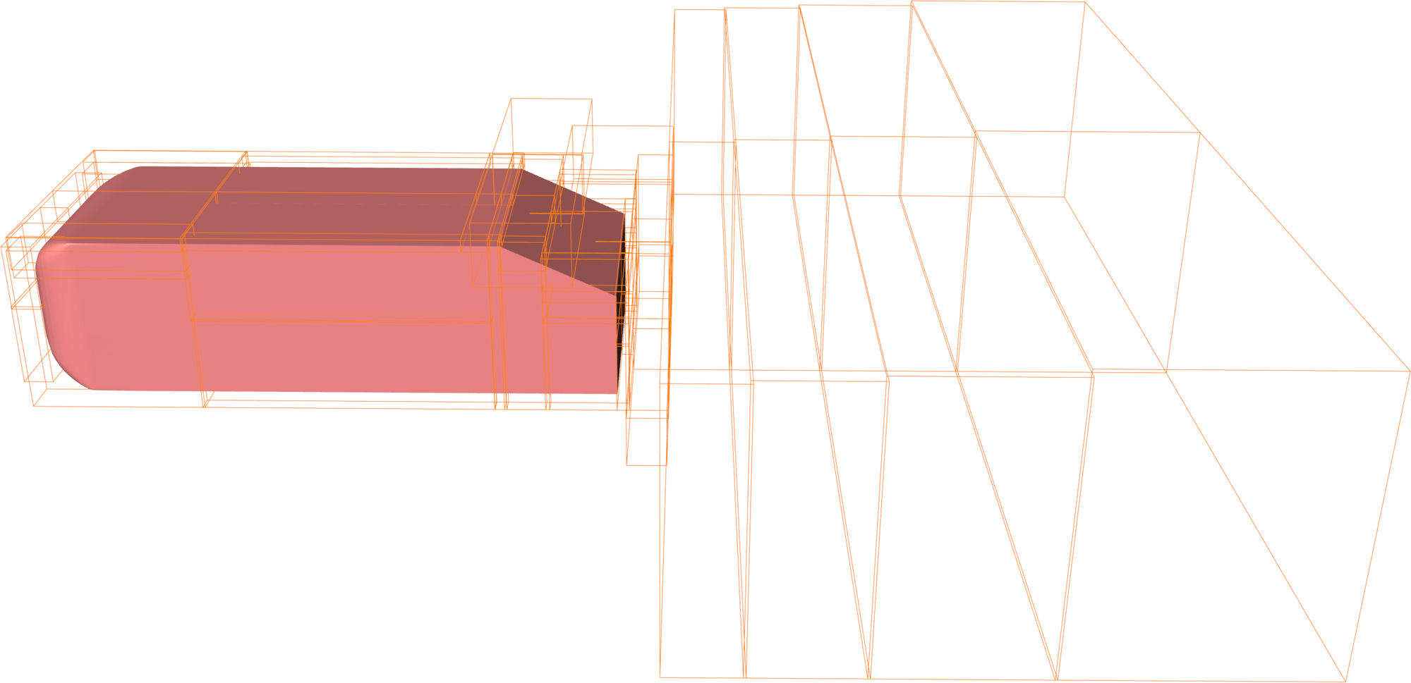
Visualization Scenarios
Demands on data storage, an example:
Ahmed body
Block-structured grid with 52 blocks
Each block is a curvilinear grid
17 million grid cells in total
Temporal resolution: a particle needs 10000 time steps from front to back of the Ahmed body
DFG-funded SFB 557
Erik Wassen, TU Berlin, Germany
2008

Slide 23
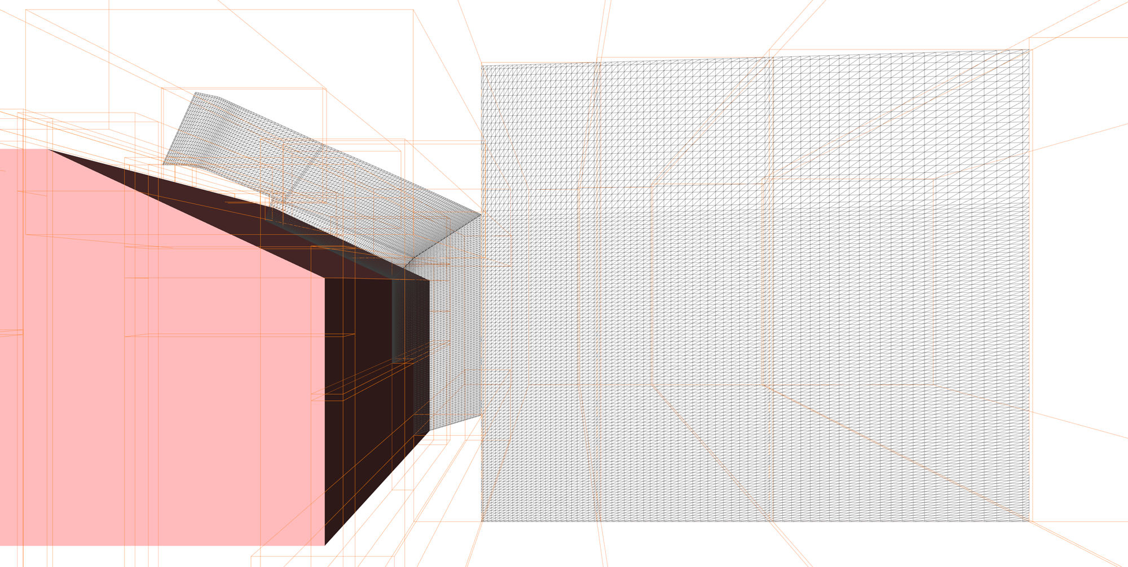
Visualization Scenarios
Demands on data storage, an example:
17 million grid cells
x 10000 time steps
x 7 variables
X 8 bytes per double
= 8.66 terra bytes
(60.62 TB for total 70000 time steps)
DFG-funded SFB 557
Erik Wassen, TU Berlin, Germany
2008
➔ Do not save every time step, not every variable, and not every block.

Slide 24
The Visualization Pipeline
Data Aspects
simulation
data bases
sensors
data acquisition
raw data
filtering
Visualization Methods
(focus of the class)
The Visualization Pipeline
vis data
mapping
renderable representation
rendering
images, video
interaction
Human Factors

Slide 25
Human Factors in Visualization

Slide 26
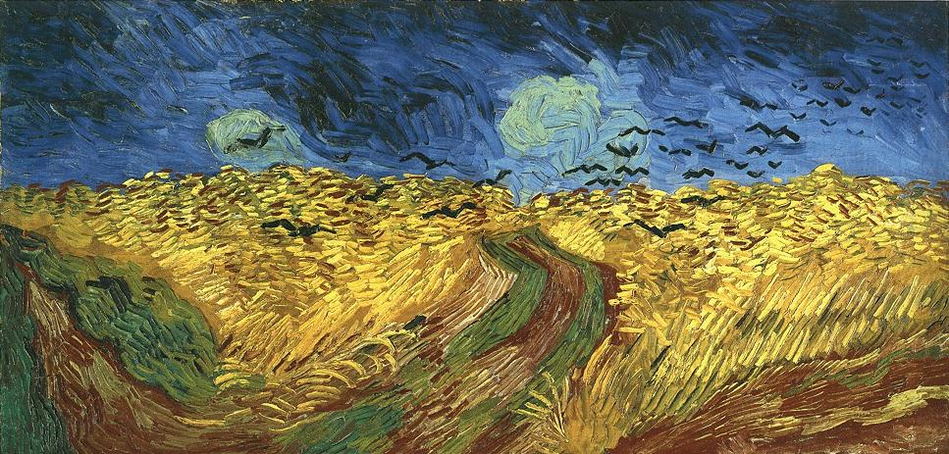
„This is Van Gogh’s last painting before he committed suicide.“
Notes:
Background information is important.
Note how the perception of the image changes with the additional knowledge of this painting being Van Gogh‘s last painting. While most of the time perception issues are not that dramatic in visualization we still need to be aware of the problem of humans interpreting images.
Remark: it‘s debatable whether this is actually van Gogh‘s very last painting but it was definitely one of his last.

Slide 27
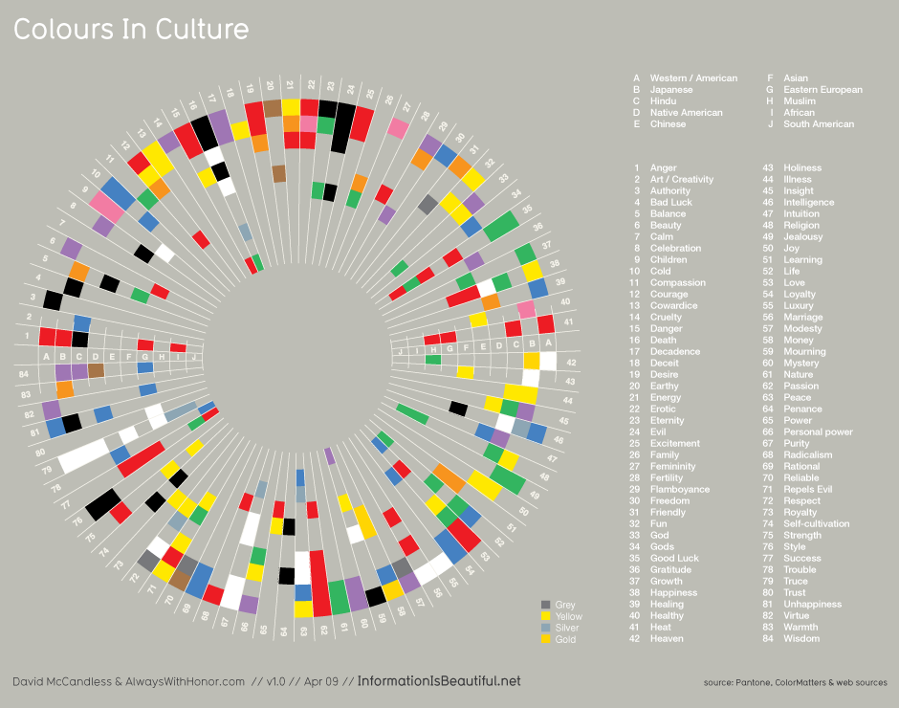

Slide 28
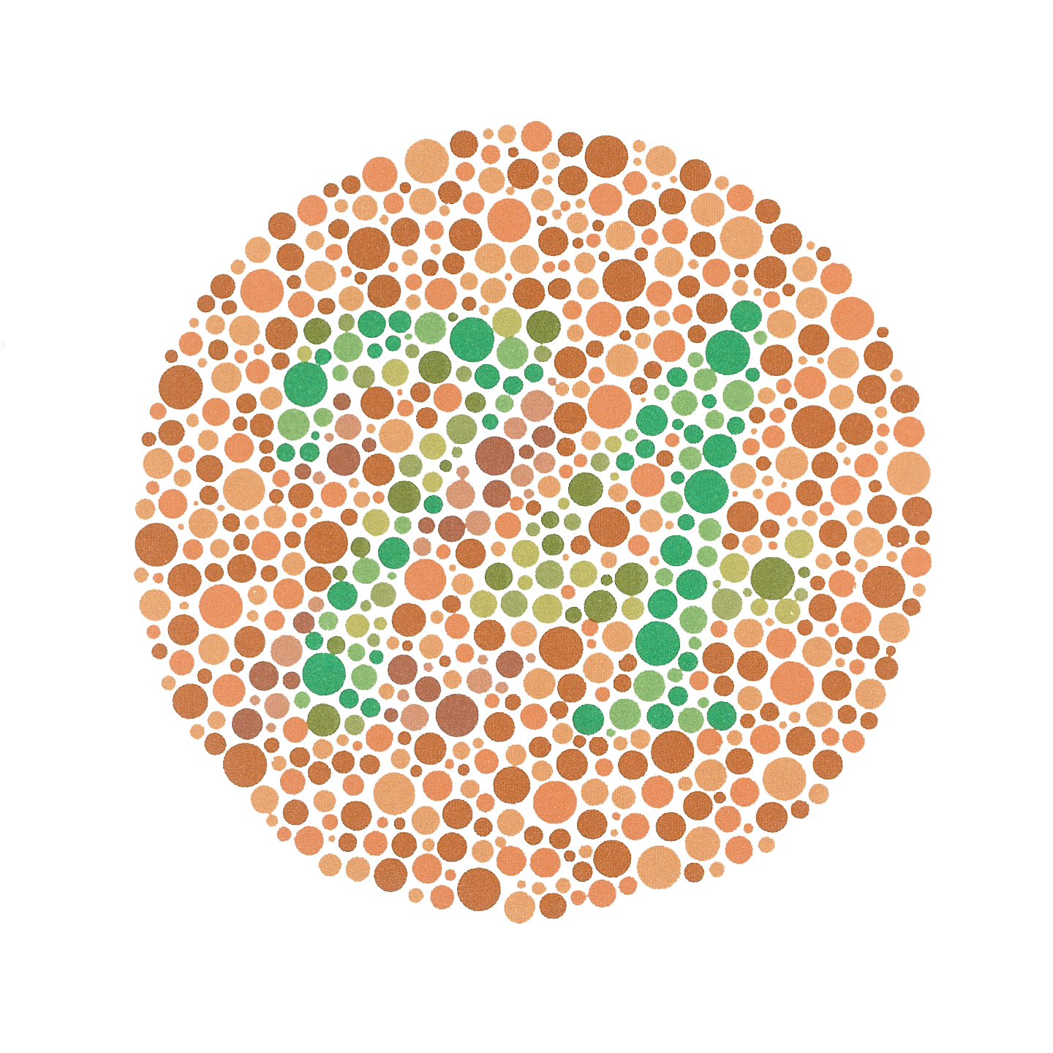
Color Blindness
The numeral "74" should be clearly visible to viewers with normal color vision.
Viewers with dichromacy or anomalous trichromacy may read it as "21“.
Viewers with achromatopsia may not see numbers.
From http://en.wikipedia.org/wiki/Color_blindness
Notes:
Red/Green
• Lack of or mutations in red or green cones
• Genes located on the X chromosome (women have 2, men have 1)
• 10% of men, less than 1% of women
Blue/Yellow
• Equally found in men & women
• mutation in short wave cone

Slide 29
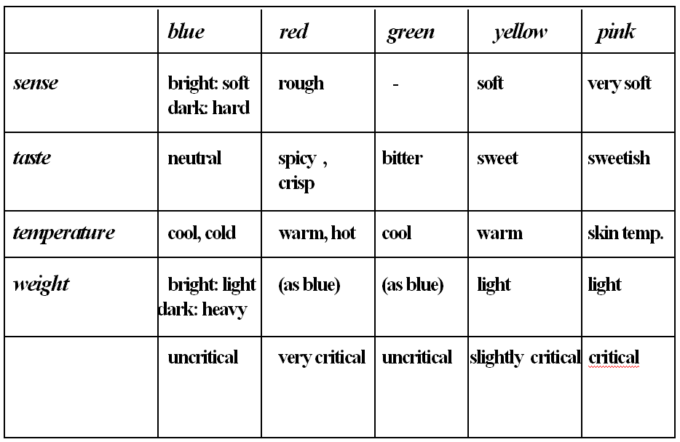
Color Perception
Colors are perceived in the following way:
Notes:
This is a general guideline and may not hold up in all instances.
Temperature:
What colors go with warm/hot?
What colors go with cold?
Taste:
Possible tastes: spicy, bitter, sweet
Colors? (red, green, yellow/pink)

Slide 30
Color Perception
Colors are perceived in the following way:
Notes:
This is a general guideline and may not hold up in all instances.
Temperature:
What colors go with warm/hot?
What colors go with cold?
Taste:
Possible tastes: spicy, bitter, sweet
Colors? (red, green, yellow/pink)

Slide 31
Human Factors in Visualization
Bertin identifies 7 graphical primitives from which the images are built (6 + color = value, hue, saturation):

Slide 32
Human Factors in Visualization
There is a variety of case studies about the perception of these primitives.
Here: a few more statements from T. Koop´s masters thesis, (TH-Darmstadt):
Size:
Human eye can distinguish up to 20 different sizes using a ratio of 1:10 between the smallest and the biggest size.
Differences in size are better perceived for dark surfaces.
Brightness:
Human eye can distinguish between 60 – 70 gray levels.
For representing nominal data only 5 – 6 levels should be used.

Slide 33
Human Factors in Visualization
Color:
Perception of colors should be considered (➔ see Mapping)
Number of distinguishable color levels relates directly to the size of the colored surface.
Diameter should be at least 1.5 mm to perceive color differences.
Color perception also depends on the adjacent colors (color bleeding).
Saturation:
Selecting property is best for pure (fully saturated) colors. Pure colors should be used for small surfaces which represent extreme values.
Saturation differences are harder to perceive than brightness differences.

Slide 34
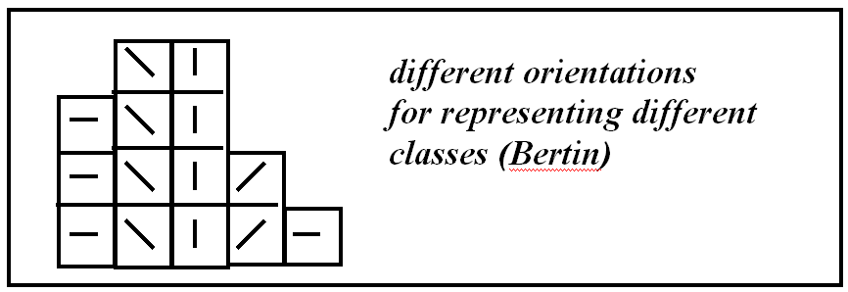
Human Factors in Visualization
Orientation:
Direction is best perceived for icons with a longish shape.
Directions are well distinguishable if angle is chosen between 30° and 60°.
Number of directions in a visualization is limited.

Slide 35
Human Factors in Visualization
Shape:
Map from shape to data is complicated.
Shape is appropriate as visual metaphor.
Shapes can be obtained by combinations, e.g.:
ShapeVis enhanced spring model
directions from star shaped coordinates

Slide 36
Human Factors in Visualization
Texture:
A collection of small objects is generally perceived as texture / pattern.
A texture with few and isolated objects is associated with „less“; texture with many objects is associated with „many“.
Further rules:
A difference of the shape of two objects can easier be perceived than a difference in the size.
Contrast facilitates perception as well as a full-range lighting.
Regular geometric shapes are easier perceivable than asymmetric shapes.
It is important,
Not to overload the human visual system in a visual representation.
Solutions: focus & context, or linking techniques.

Slide 37
Data Description

Slide 38
Data Description
What kind of data do you know?
Give examples!
Notes:
Table / Spreadsheet (Excel) Scalar, Vector, Tensor Fields
Images (Photos)
Videos
Text
HTML, XML (Trees)
Graphs

Slide 39
Data Description
Scientific data are [Brodlie 92], [Bergeron 93], [Wong 97]
m-dimensional data, which are gathered in an
n-dimensional observation space.
We distinguish between:
independent variables: dimensions which define the observation space
➔ „multidimensional data“
dependent variables: the parameters observed in the observation space
➔ „multivariate data“
Fundamental visualization aims for multiparameter data are:
Which values attain the dependent variables?
In which spatial context are these values given?
In which temporal context are these values given?

Slide 40
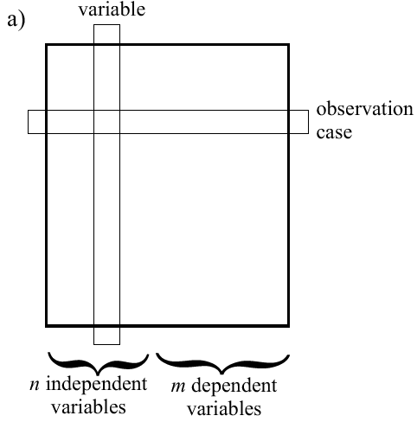
Data Description
Common way of describing multiparameter data: table in which independent and dependent variables are marked:

Slide 41
Data Description
Observation space is actual space & time
Often the case in physics, medicine, chemistry, geology, …
Many numerical methods available (derivatives, interpolation, …)
The class will concentrate on visualization methods for that kind of data, starting with the next lecture.
No specific prior on observation space
Often the case with business data, data bases, abstract spaces, …
Few general methods exist
Many guidelines exist
We will look into this area today.

Slide 42
Classification Scheme for Visualization Methods

Slide 43
Classification Scheme for Visualization Methods
static
dynamic
partial
2D
complete
3D

Slide 44
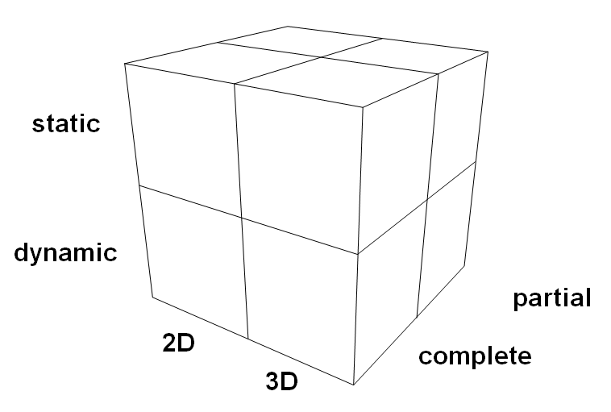
Classification Scheme for Visualization Methods
2D vs. 3D
2D:
no projections or visibility computations
data values easily identifiable
3D:
projections and visibility computations
additional dimension for coding the data values
natural 3D interpretation by using depth cues (e.g.: transparency, perspective, shadows, ...)

Slide 45
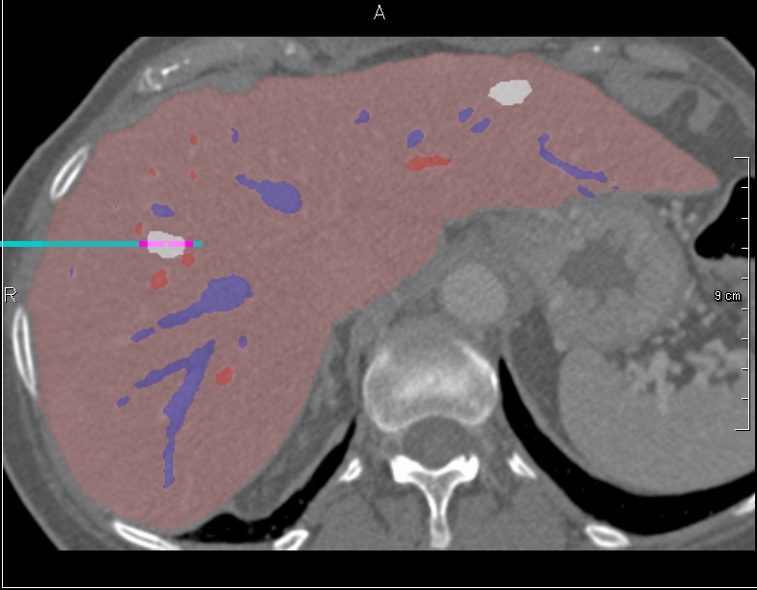
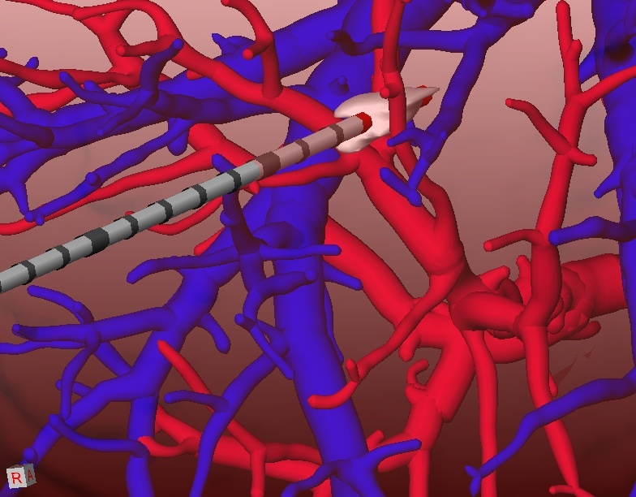
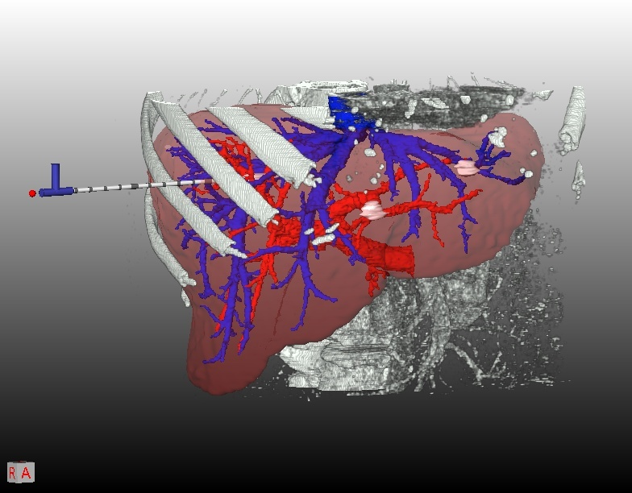
Classification Scheme for Visualization Methods
2D vs. 3D
Combination opportunities
Example: positioning of an applicator in a medical volume data set by means of a 2D and 3D detailed view and a 3D overview

Slide 46
Classification Scheme for Visualization Methods
static vs. dynamic
static:
do not change automatically (changes are results of interactions)
appropriate for getting quantitative statements
dynamic:
change automatically
time axis for coding additional information
appropriate for showing continuous changes

Slide 47
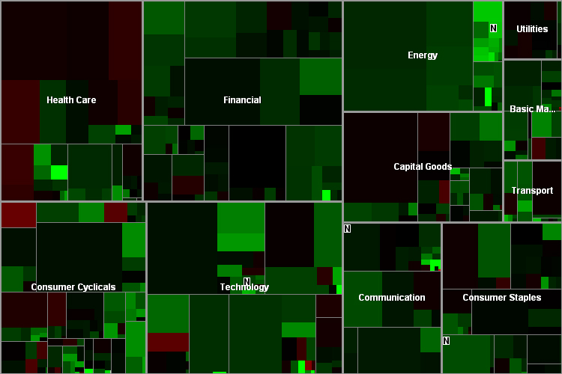
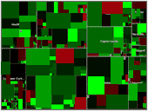
Classification Scheme for Visualization Methods
Static vs. Dynamic Visualizations
Example: Static and dynamic Treemap visualization of finance data (www.smartmoney.com/map-of-the-market/)
Notes:
Bild:
-Zeigt Börsenentwicklungen über ein Jahr
-zwei Level: Industriesektoren und Firmen
-Rechteckgröße (Blattgröße) zeigt Marktkapitalisierung einer Firma: Aktienkurs * im Umlauf sich befindende Aktien der Firma
-Industriesektoren sind Nicht-Blattknoten
-Farben stellen Änderungen des Aktienkurses dar: rot ➔ Rückgang, schwarz ➔ unverändert, grün➔ Wachstum
-Interkation: Details über einzelne Firmen durch Annotationen, Suche nach bestimmten Firmen, Wahl der Farbabbildung
Interpretation:
-starkes Wachstum ist anhand von hellen, grünen Rechtecken erkennbar
-Baumstruktur (Nicht-Blatt Knoten) durch graue Linien dargestellt, Linienbreite kodiert Baumtiefe

Slide 48
Classification Scheme for Visualization Methods
complete vs. partial
complete:
show all data in one image
size of data set limited
partial:
show subsets of data set
requires interaction techniques to control the reduction
without navigation or linking techniques: loss of information
enables analyses of individual parts of the observation space and feature space

Slide 49
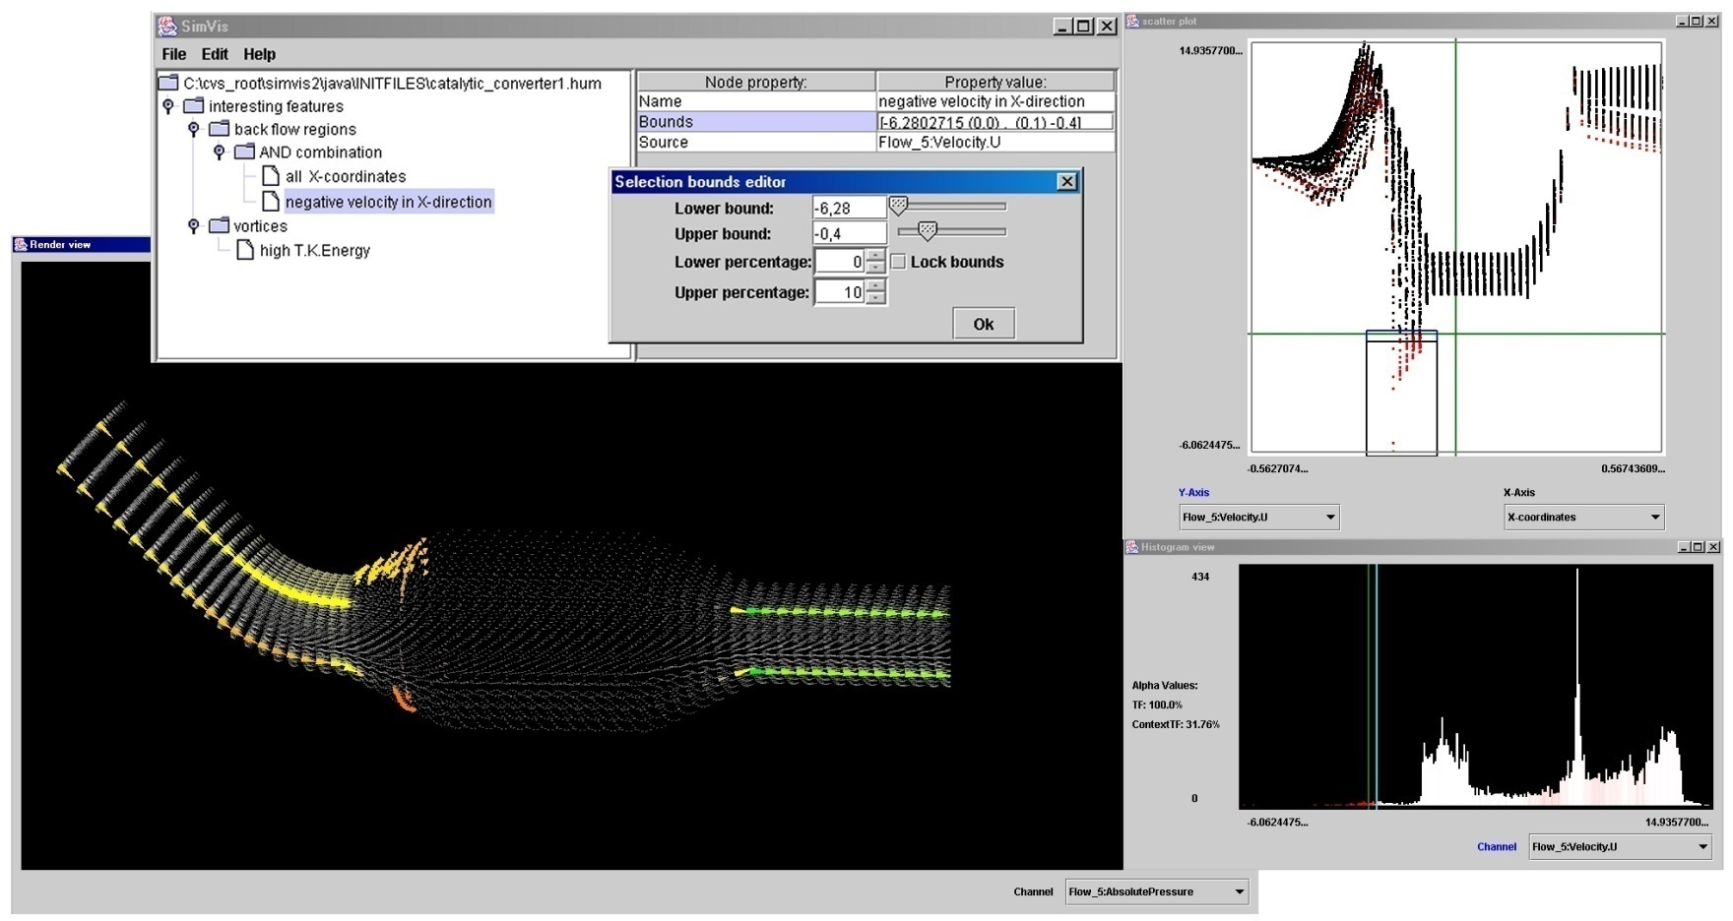
Classification Scheme for Visualization Methods
Complete vs. Partial Visualizations
[From Doleisch et al., 2003]
Example: Partial visualization of simulation data of a catalytic converter (Katalysator). Reduction is controlled by specifying features by means of linking and brushing. (From: Doleisch et al., 2003)
Notes:
Source:
http://www.vrvis.at/vis/research/fdl-vis/
Doleisch, Helmut; Gasser, Martin; Hauser, Helwig: "Interactive Feature Specification for Focus+Context Visualization of Complex Simulation Data.", In: Proceedings of the 5th Joint IEEE TCVG - EUROGRAPHICS Symposium on Visualization, VisSym‘03 (2003) 239-248

Slide 50
Wednesday, 10.15: Coding tutorial
Bring your laptop
Clone Inviwo from Github (see Canvas)
Cmake
Qt

Slide 51
Visualization of Multiparameter Data
No specific prior on observation space

Slide 52
Visualization of Multiparameter Data
General Remarks and Classification
Aim: abstraction of properties of the observation space
while keeping
important correlations:
values per observation point
values per observation case
values per dependent variable.

Slide 53
Visualization of Multiparameter Data
First method: scatter plot
Cylinders | Horsepower (PS) | Weight (kg) | Origin
4 | 110 | 1576 | Germany
6 | 105 | 3535 | Japan
8 | 150 | 4190 | U.S.A.
Dimension B
Dimension A

Slide 54
Visualization of Multiparameter Data
Classification for distinguishing basic technologies for visualization of multiparameter data
panel matrices
line sequences
icon based techniques
pixel based techniques
hierarchical techniques

Slide 55
Visualization of Multiparameter Data
Panel matrices
Idea: configuration of bivariate representations of the n-dimensional observation space in matrices
Examples: scatterplot matrices; prosection views; hyper slices
scatterplot matrices (Cleveland 93)
configuration of scatterplots in a matrix for showing different combinations of variables
prosection views (Furnas, Buja, 1994)
matrix of all orthogonal projections for specified regions of the observation space (prosection = combination of selections and projections)
hyper slice (van Wijk, J. J., van Liere R. D., 1993)
matrix of n² slices through the n-dimensional observation space which intersect in a point of interest (current point) .
(navigation in observation space possible by moving the current point.)

Slide 56
Visualization of Multiparameter Data
Scatterplot matrix, Cleveland 93
configuration of scatterplots in a matrix for showing different combinations of variables

Slide 57
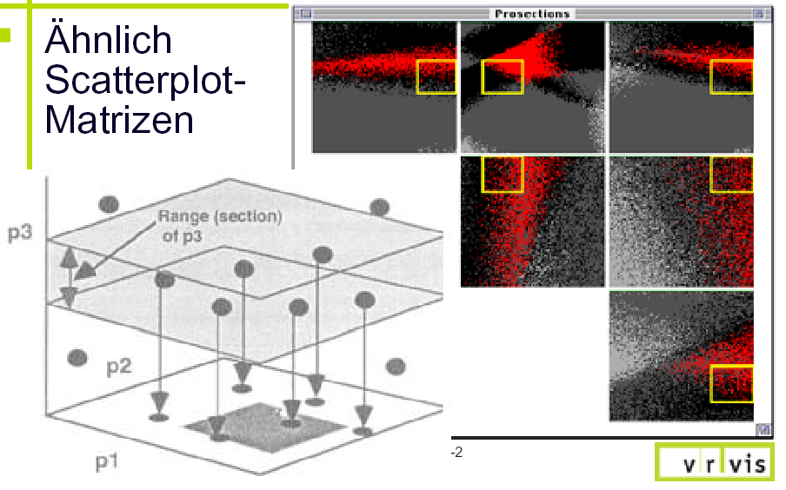
Visualization of Multiparameter Data
Prosection Views
matrix of all orthogonal projections for specified regions of the observation space (prosection = combination of selections and projections)

Slide 58
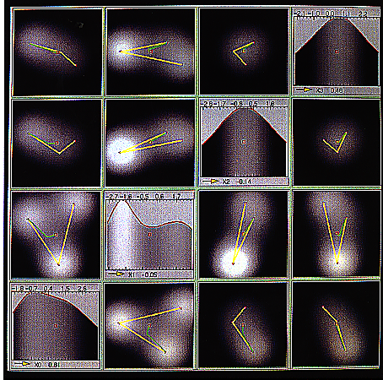
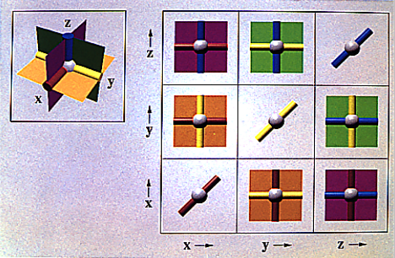
Visualization of Multiparameter Data
Hyper slice (van Wijk, J. J., van Liere R. D., 1993)
matrix of n² slices through the n-dimensional observation space which intersect in a point of interest (current point). (navigation in observation space possible by moving the current point.)

Slide 59
Visualization of Multiparameter Data
Line sequences
idea: mapping points of observation space to line sequences
examples:
parallel coordinates,
3D parallel coordinates,
star shaped coordinates,
parahistograms

Slide 60
Visualization of Multiparameter Data
very important
Parallel coordinates (Inselberg, 1990)
n-dimensional parallel coordinate ­system in plane is defined by n parallel axes x₁, x₂, ..., x_{n}
A point P with the coordinates (p₁, p₂, ..., p_{n}) in n-dimensional observation space is represented by a line sequence in parallel coordinates. This line sequence is defined by the points P₁, P₂, ..., P_{n} on the axes x₁, x₂, ..., x_{n} of the parallel coordinate system. P_{i} lies on x_{i} and has the coordinate p_{i} (i = 1,2,...,n).

Slide 61
Visualization of Multiparameter Data

Slide 62
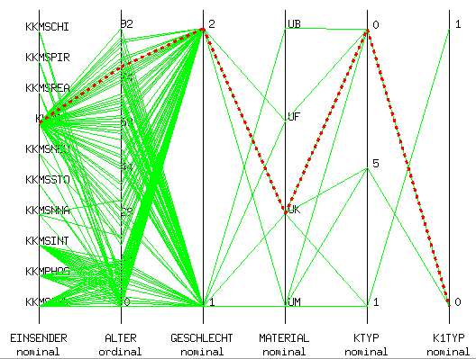
Visualization of Multiparameter Data
microbiological data set using parallel coordinates

Slide 63
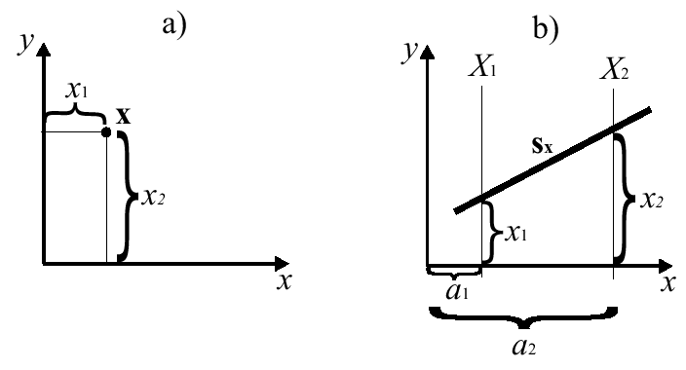
Visualization of Multiparameter Data
Point-line duality for parallel coordinates
The point x in a) represented by the line s_{x} in parallel coordinates in b).

Slide 64
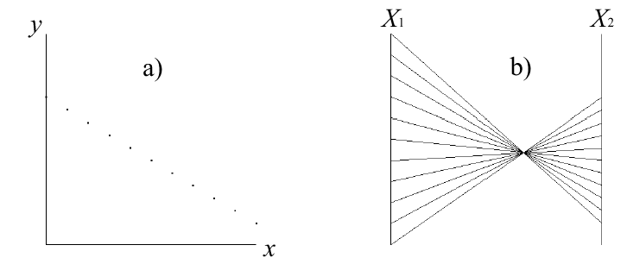
Visualization of Multiparameter Data
Point-line duality for parallel coordinates
A straight line in the Cartesian coordinate system (a) is found as the intersection point of the lines in Parallel Coordinates (b). These lines in PC are defined by the sample points on the straight line.
The intersection is not necessarily between X₁ and X₂
An intersection point is not defined, if the slope of the straight line is 1, since then the lines in PC are parallel to each other.

Slide 65
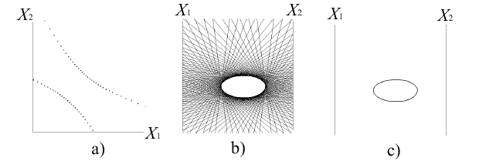
Visualization of Multiparameter Data
Conic-conic duality for parallel coordinates

Slide 66
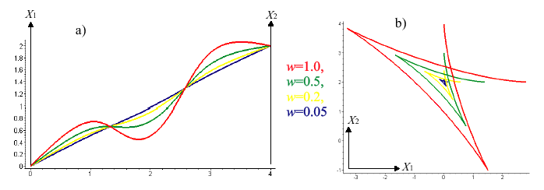
Visualization of Multiparameter Data
Curve-curve duality for parallel coordinates
Cusp <-> inflection point duality

Slide 67
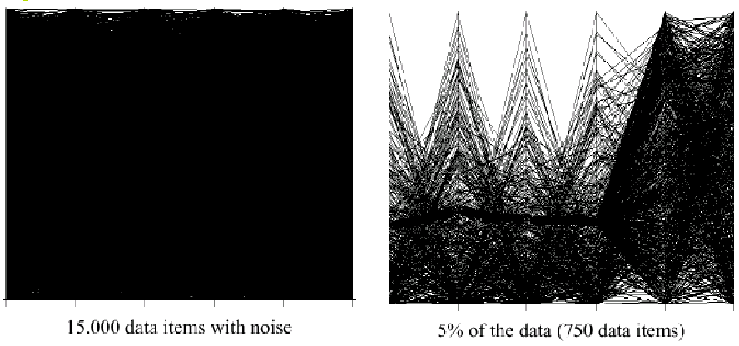
Visualization of Multiparameter Data
lines need space!

Slide 68
Visualization of Multiparameter Data
Parallel coordinates (Inselberg, 1990)
for the visual analysis it is important to offer interaction tools, such as:
reducing the number of axes;
exchange axes;
scaling axes;
reducing the number of line sequences;
emphasize particular line sequences.
Show live demo

Slide 69
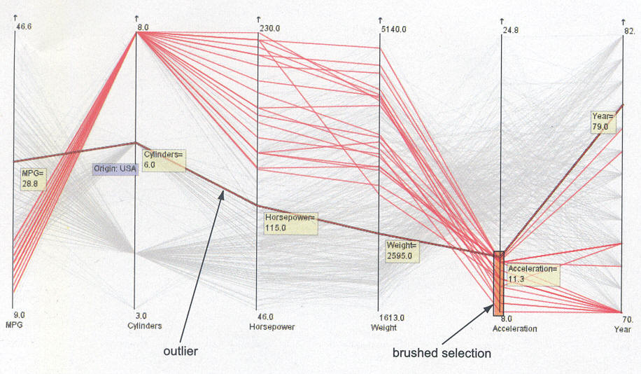
Visualization of Multiparameter Data
Brushing selections to select subsets
Car example (speed, cylinders, PS, weight, acceleration) from: [Telea, 2008]

Slide 70
Visualization of Multiparameter Data
3D Parallel Coordinates:
parallel planes instead of parallel axes; each plane is described by two axes; two variables can be mapped to each plane.
Weinkauf, Köller, University of Rostock, 1997

Slide 71
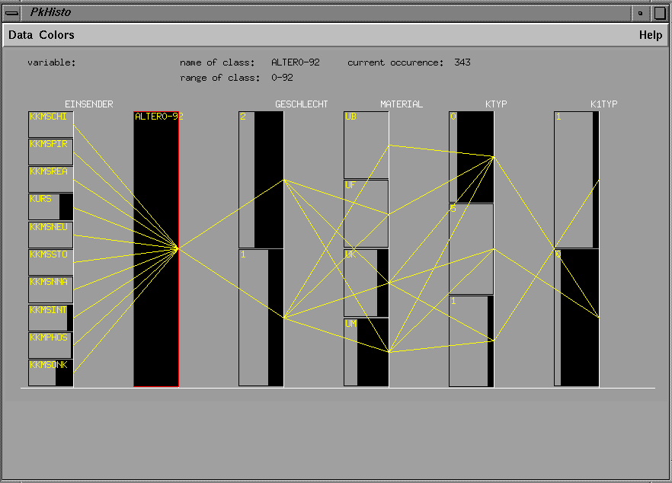
Visualization of Multiparameter Data
Parahistograms (WINVIZ, Ong, Lee: 1996)
extension of parallel coordinates by integrating histograms to show the number of data values.

Slide 72
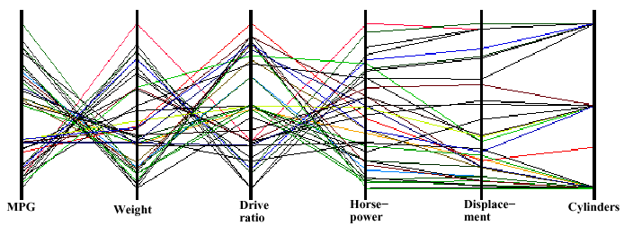
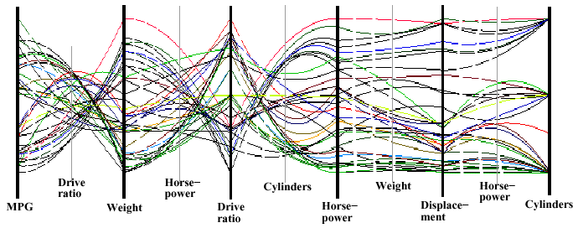
Visualization of Multiparameter Data
Higher order parallel coordinates (Theisel 01)
Place additional coordinate axes between the “main” axes, use free-form-curves instead of straight line segments.
Example: car data set: 6 dimensions, 38 objects.
normal parallel
coordinates
“higher order parallel coordinates”
(shows correlations between (Horsepower, Weight, Displacement), (Displacement, Horsepower, Cylinders).

Slide 73
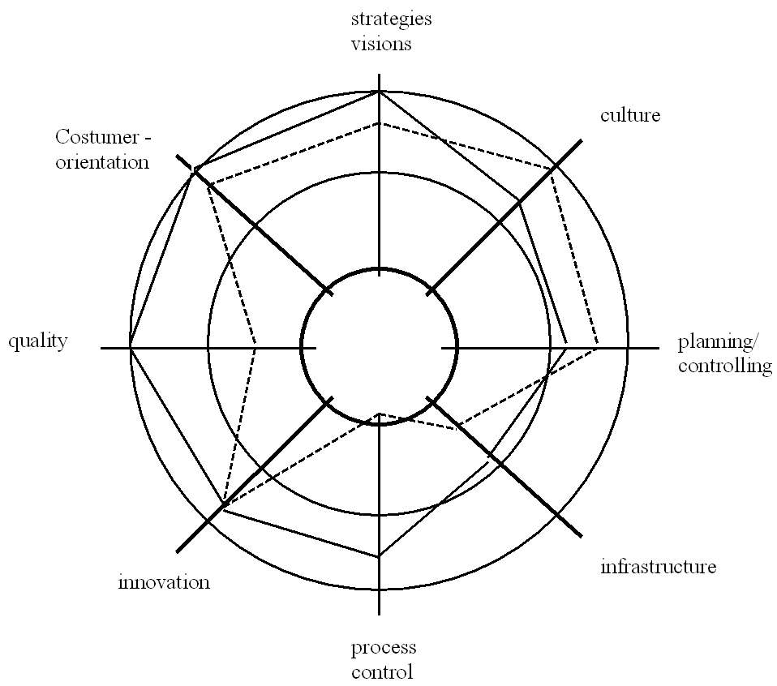
Visualization of Multiparameter Data
Star shaped coordinates:
similar to parallel coordinates but star shaped configuration of coordinate axes
Properties of a company
using star shaped coordinates (Kiviatgraph)

Slide 74
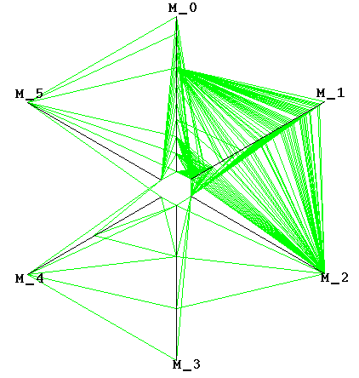
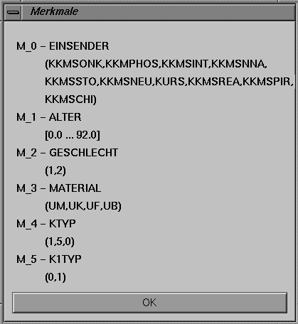
Visualization of Multiparameter Data
Example for star shaped coordinates

Slide 75
Visualization of Multiparameter Data
Assessment of Parallel Coordinates and derived methods:
good:
lossless maps possible;
both qualitative and quantitative statements possible;
correlation between two dimensions well recognizable.
bad:
hard to trace particular line segments for large data sets (especially for parallel and star shaped coordinates)
correlations between more than two dimensions are difficult to see

Slide 76
Visualization of Multiparameter Data
Icon based techniques
idea: visualization of data values as properties of icons / glyphs. ➔ One icon represents the values of one observation case.
There is no unique distinction between the names „icon“ and „glyph“ in the literature. In most cases they have the same meaning.
Glyphs/icons are geometric objects with the following properties:
can be located at exact positions; these positions give spatial information.
encode values of physical variables:
in geometric characteristics like angle, length or shape,
in attributes of the representation like color or transparency.

Slide 77

Visualization of Multiparameter Data
Icons are used for encoding more than 3 parameters.
These parameters should have the following properties:
parameters in an icon should be easily combinable.
parameters should be separately perceivable.
icons should differ significantly if the coded parameters differ.
The development of effective geometric codes is not trivial!
One of the first (and most well-known) icons is the Chernoff face (Chernoff 1973).
It codes 12 variables in the form of head, nose, mouth, eyes

Slide 78

Visualization of Multiparameter Data

Slide 79
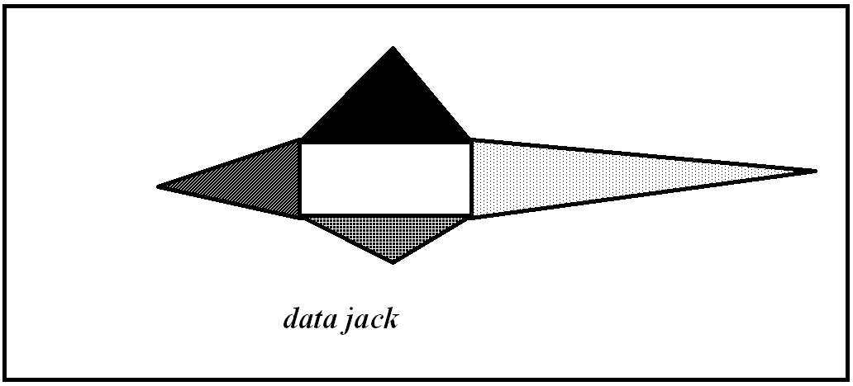
Visualization of Multiparameter Data
Further examples
data jacks (Cox, Ellson, Olano)
3-dimensional figures consisting of 4 elements
data values are coded in color and length of these elements.

Slide 80
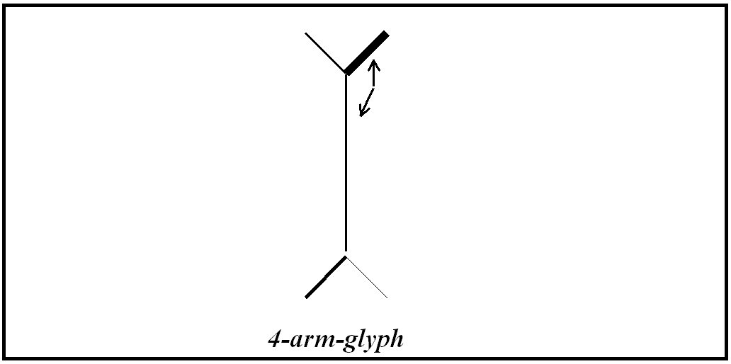
Visualization of Multiparameter Data
Further examples
m-arm-glyph, stick figures (Pickett, 1970; Pickett & Grinstein, 1988)
2-dimensional figure with m arms; data values are coded in
Length,
Width, and
Angle to main axis
of the arms.

Slide 81
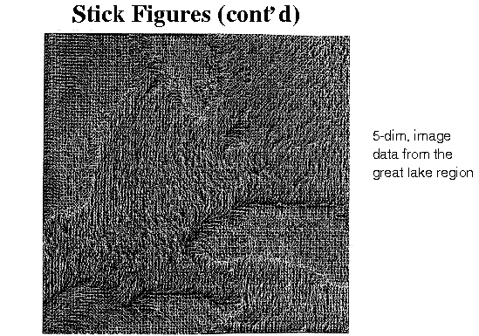
Visualization of Multiparameter Data
Stick figure example:

Slide 82
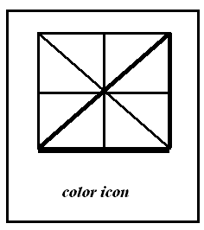
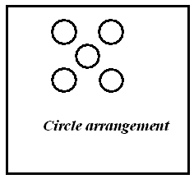
Visualization of Multiparameter Data
Color icon (Levkowitz)
uses color, shape, and texture features;
data values are coded
in linear feature (edges, diagonal), or
in triangles.
Circle arrangements
codes data values in size and color of circles

Slide 83
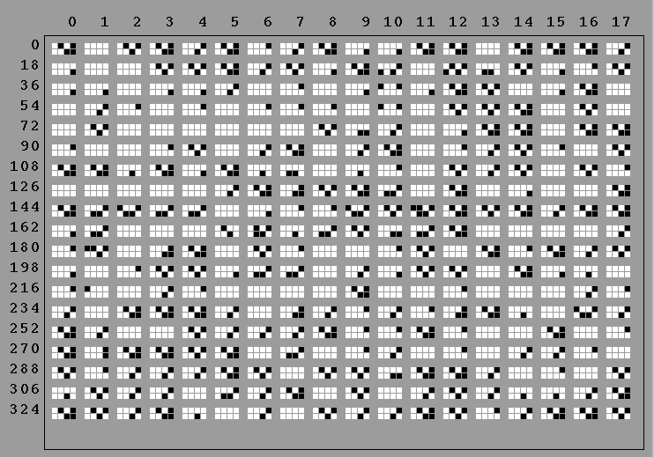
Visualization of Multiparameter Data
Shape coding (Beddow, 1990)
Icon is a rectangle containing a regular grid. Each grid cell is used for one parameter.
The value of the parameter is coded in color.
The rectangular icons are usually placed row-wise. Hence, certain order criteria can be considered. (temporal or spatial correlations, ordering according to special data values).

Slide 84
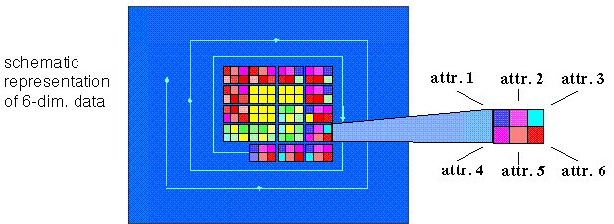
Visualization of Multiparameter Data
Spiral shaped arrangement of a car glyph
The rectangular icons are usually placed row-wise.
➔ Other configurations of the icons are possible. (spiral shaped configuration, grouping techniques, Keim, Kriegel, 1994)

Slide 85
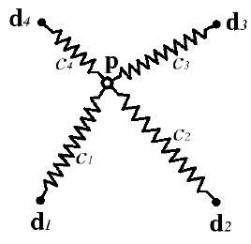
Visualization of Multiparameter Data
ShapeVis (Theisel/Kreuseler 98)
Based on enhanced spring model
Classic spring model (Problems: ambiguity, insensitivity to coordinate scaling):
Every dimension is represented by a dimension point d_{i} (i=1..m) on a sphere
An observation case O=(c₁,...,c_{m}) is represented by a point p
Springs from p to d_{i} with the stiffness c_{i} ➔ search for position of balance of p.

Slide 86
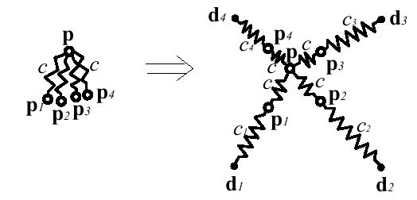
Visualization of Multiparameter Data
Solution: observation case described by points p,p₁,...,p_{m}:
Then construct surfaces out of p,p₁,...,p_{m} in such a way that an observation case is uniquely described by its location, size and shape.

Slide 87

Visualization of Multiparameter Data
Example: car data set
Overview

Slide 88

Visualization of Multiparameter Data
Example: car data set
Zoom into a cluster

Slide 89
Visualization of Multiparameter Data
Assessment of icon based techniques
good:
perception of parameter correlation and groupings possible;
icons can be positioned in observation space;
big data sets can be handled.
bad:
hard to identify particular data
(exception: nominal parameters with small range)

Slide 90


Visualization of Multiparameter Data
Pixel oriented techniques
Idea:
visualization of data values as color coded pixels; color coding of the data values is done in a separate window for each parameter.
➔ visualization of large data sets possible.
Arrangement of the pixels has to be specified:
Row-wise
Column-wise
Other patterns

Slide 91
Visualization of Multiparameter Data
2 step techniques:
pixels organized in small groups
arrangement of the groups
Recursive pattern technique (Keim, Kriegel, 1995)
recursive arrangement of the groups

Slide 92

Visualization of Multiparameter Data
Example for recursive pattern technique: A measurement station yields 5 parameters three times daily: air pressure, humidity, temperature, O₂- and CO₂ concentrations.
Pixel arrangement:
1st level: create a 3 * 5 pattern which codes the daily measures row-wise.

Slide 93

Visualization of Multiparameter Data
2nd level: create a 5 * 7 pattern which codes measured values of a month in a weekly left-right-arrangement.

Slide 94

Visualization of Multiparameter Data
3rd level: create a 20 * 12 Pattern with the measured values of 20 years; monthly in a left-right-arrangement

Slide 95

Visualization of Multiparameter Data
Result: image of 300 * 420 pixels representing 126000 data values

Slide 96

Visualization of Multiparameter Data
Example:
Stock prices of the FAZ index , Jan 74 – April 95

Slide 97
Visualization of Multiparameter Data
Assessment of pixel based techniques
good
visualization of big data sets possible
bad:
effective arrangements are necessary
problems with color perception and distinction on pixel level

Slide 98
Visualization of Multiparameter Data
Hierarchical methods
Principle: visualization of data values using hierarchical parameter arrangements

Slide 99
Visualization of Multiparameter Data
Dimensional stacking (Leblanc, Ward, Wittels, 1990)
starting point:
m parameters P₁ to P_{m} with m cardinal numbers K₁ to K_{m}
(cardinal number = number of classes in the domain of each parameter)
idea: define pairs of parameters and combine them
steps:
choose the most important parameters P_{i}, P_{j}; define a 2D grid K_{i} x K_{j};
recursive subdivision of each grid cell using the next pairs of parameters;
color coding of the final grid cells using:
the value of a dependent parameter
or
the frequency of data in each grid cell

Slide 100


Visualization of Multiparameter Data
Example 1:
5-dimensional parameter set (P₁=location, K₁=3; P₂=time, K₂=4; P₃=agent, K₃=4; P₄=customer group, K₄=4; P₅=exchange, K₅=10)
build pairs of parameters out of P₁ ,..., P₄,
color code P₅

Slide 101

Visualization of Multiparameter Data
Example 2:
microbiological data set
define pairs of parameters
color code: frequency

Slide 102

Visualization of Multiparameter Data
Problems:
effective definition of the parameter pairs
effective partition
level of recursion

Slide 103

Visualization of Multiparameter Data
Worlds-within-Worlds (Feiner, Beshers, 1990)
Approach similar to dimensional stacking:
choose a triple of parameters; defines a 3D coordinate system;
choose a point in this coordinate system; define another coordinate system by choosing three more parameters at this point;
define triples of parameters and coordinate systems recursively;
visualize values in the last-defined coordinate system.

Slide 104

Visualization of Multiparameter Data
Worlds-within-Worlds (Feiner, Beshers, 1990)

Slide 105
Visualization of Multiparameter Data
Assessment of hierarchical methods:
good:
supports level of detail (LOD) and focusing
switch between overview and detail visualizations possible
bad:
effective parameter pairing & ordering has to be given / created

Slide 106

Visualization of Multiparameter Data
Summary
Consider the techniques concerning the following fundamental aims:
perceive relations between parameters,
identify individual values.

Slide 107
Visualization of Multiparameter Data
This tables shows only a trend. Reasons for this are:
Methods in each group differ
Annotation plays a role
Interaction issues play a role
Can exact values or additional information be obtained by mouse-clicking?
Can axes be scaled or replaced ?
Is data set interactively reducible?
Are selections possible ?
...
Another problem is the treatment of missing values:
Do not display them (e.g., background color for pixel-oriented techniques)?
Special treatment of missing values?

Slide 108
Visualization of Multiparameter Data
Visualization of the Observation Space

Slide 109
Visualization of Multiparameter Data: Observation Space
Visualization of the spatial context
Here we consider the visualization of the dimensions of the observation space, which define a spatial coordinate system.
Aim: show the correlations between data values and their spatial position.

Slide 110
Visualization of Multiparameter Data: Observation Space
3 cases can be distinguished (relating to the 3 types of impact areas) (see Robertson):
point context correlation between data values and particular points in observation space (i.e. measured values per observation point in a lake)
local context
data values in a local environment (i.e. data values in the northern part of the lake)
global context
distribution of data values in the whole observation space (i.e. data values for the whole lake)
Here we consider n=2 and n=3. (grid dimensionality)

Slide 111
Visualization of Multiparameter Data: Observation Space
Two kinds of representing the spatial context:
Direct spatial context
observation space and data values are shown in one visual representation; correlations are realized by positioning.
Intuitive perception of spatial context;
Limited number of values can be visualized.
Indirect spatial context
observation space and data values are shown in different visual representations; correlations are realized using special encodings (color; annotations, ...)
spatial context perceivable but not as intuitively as in direct spatial context;
larger number of values can be coded.
Combination of direct and indirect representation of spatial context

Slide 112


Visualization of Multiparameter Data: Observation Space
Direct representation of spatial context

Slide 113

Visualization of Multiparameter Data: Observation Space
Indirect representation of spatial context

Slide 114

Visualization of Multiparameter Data: Observation Space
Indirect representation of spatial context

Slide 115

Visualization of Multiparameter Data: Observation Space
Combination indirect/direct spatial context

Slide 116
Visualization of Multiparameter Data: Observation Space
Visualizing the temporal context
If one dimension of the observation space is the time axis, the data set has a temporal context.
Representation of temporal context is not necessarily related to the physical „time“.

Slide 117
Visualization of Multiparameter Data: Observation Space
Temporal context: We distinguish between
Temporal context of the data
data which changes over time (dynamic data)
data which does not change over time (static data)
data which is constant in sufficiently small periods (quasi-static data)
Temporal context of the graphical representation
visual representations which change over time (dynamic representations)
visual representations which do not change over time (static representations).
All combinations between temporal content and graphical representation are possible and make sense: see following examples

Slide 118
Visualization of Multiparameter Data: Observation Space
Static representations for:
Static data
If the data does not change over time, a static representation is adequate.
A temporal context can be represented by an annotation. (e.g., time of data observation; time interval in which data are valid)
Dynamic data
Static representations are appropriate for dynamic data especially if quantitative statements are to be given (e.g., time diagrams, time axis in parallel coordinates, multi-window-techniques, special icons).
Quasi-static data
For quasi-static data, quasi-static representations are appropriate; examples: Worm Plots (Treinish et al., 1997).

Slide 119



Visualization of Multiparameter Data: Observation Space
Construction of a circle in a time step
Construction of a worm over several time steps
Worm Plots (Treinish et al., 1997)
“scatterplots connected over time”

Slide 120
Visualization of Multiparameter Data: Observation Space
Dynamic representations for:
Static data
If the static data too complex to be represented in one static representation: dynamic representation is an alternative.
Dynamic data
Dynamic representations are appropriate for dynamic data. Animated image sequences show parameter changes and trends (e.g., animated flow visualization using particles).
Quasi-static data
Representation must not show more dynamics than in the data.

Slide 121


Visualization of Multiparameter Data: Observation Space
Example: Topological flow visualization (dynamic data)
dynamic representation ⬅ dynamic data ➔ static representation

Slide 122
Visualization of Multiparameter Data: Observation Space
Visualization of abstract dimensions
Observation space may contain dimensions with neither spatial nor temporal context.
These dimensions are called abstract dimensions.
Abstract dimensions are defined to:
compare and order data sets (introduce ordering number);
simplify data sets (use city or area names instead of a geographical reference system) or
show higher-dimensional dependencies.
For visualizing abstract dimensions, methods for multivariate data can be used. Distinction between these abstract dimensions and dependent variables should be possible.

Slide 123

Visualization of Multiparameter Data: Observation Space
Example for abstract dimensions
abstract dimension:
counties in a region of Germany; abbreviated by their license plate number
number of infections

